Slide 1
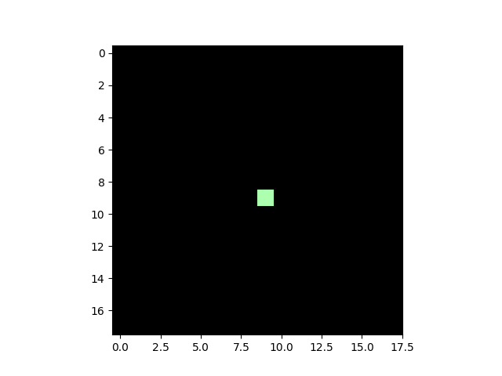
Current parametrized “DoG”

Slide 2
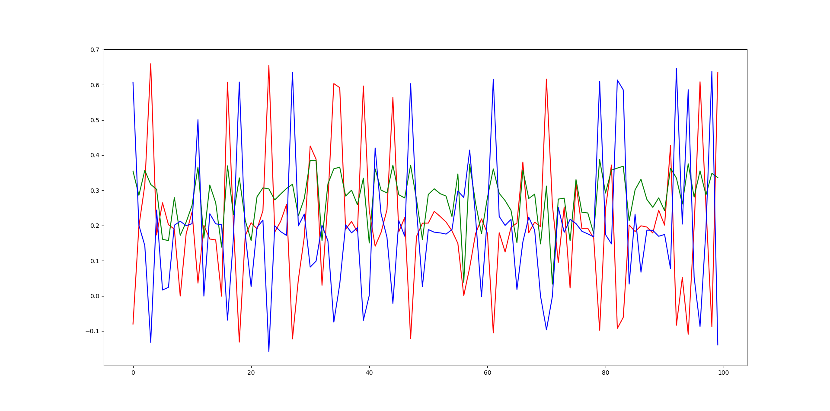
Estimated d parameters

Slide 3
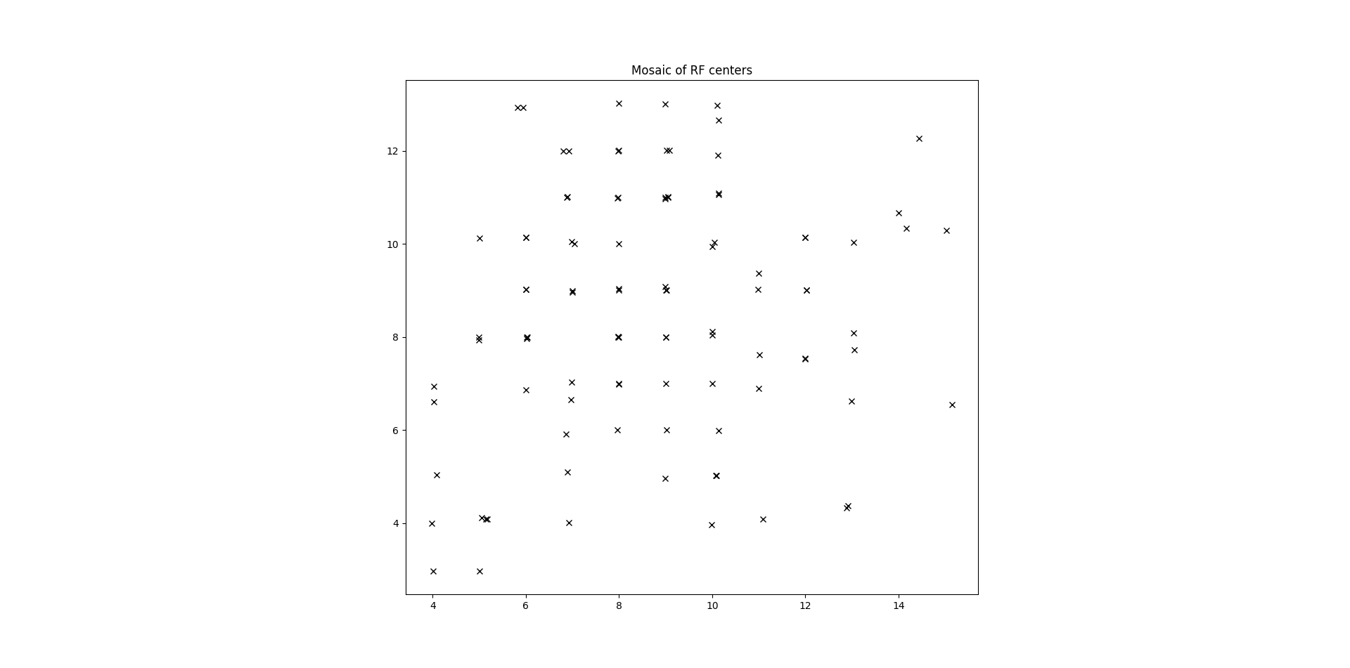
Mosaic

Slide 4
Questions I want to ask
It doesn’t seem to take less time to train the model. Should I use less epochs with parametrized DoG?
Circuitry of midget cells (L-ON center M-OFF surround, etc).
OFF S pathway

Slide 5
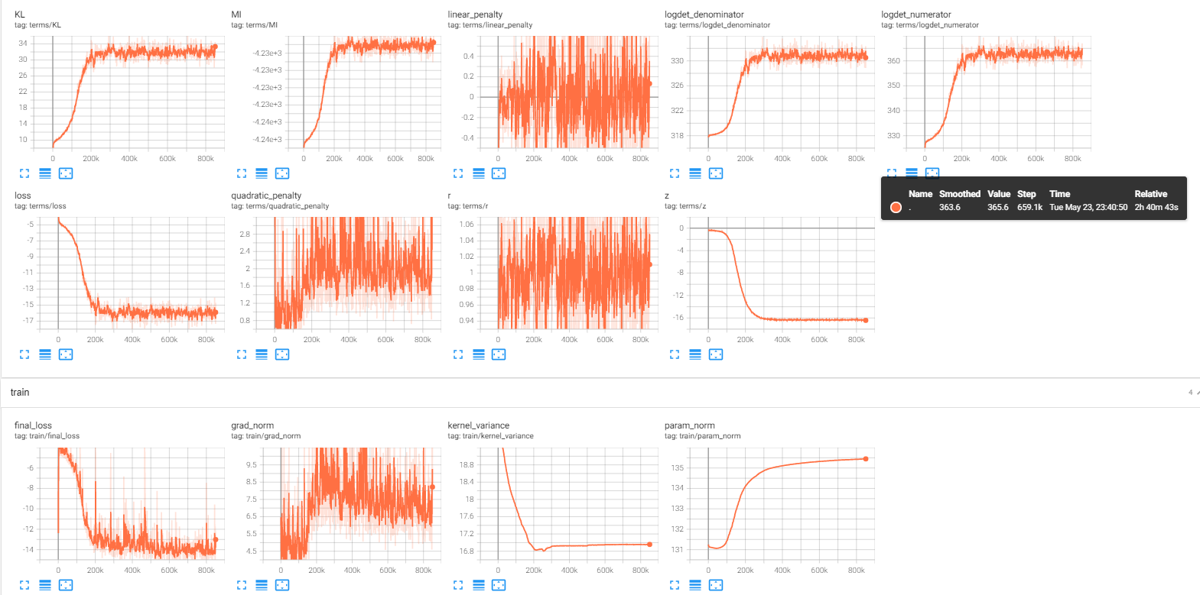

Slide 6
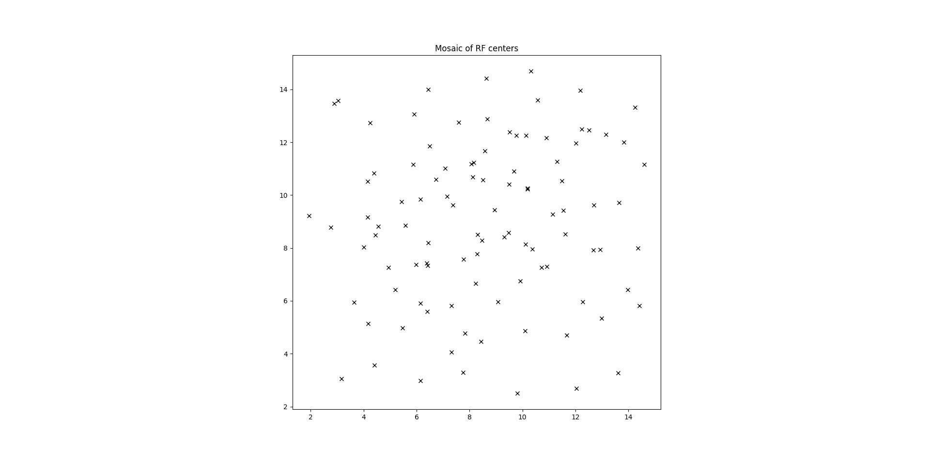
Monochromatic mosaic

